Slide 1


Assignment
15-04-2025
Presented by S. Vinish

Slide 2
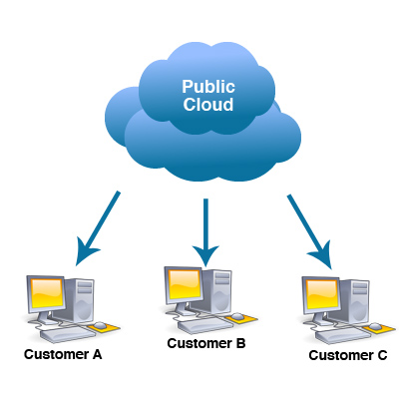
Level of Security in Public and Private Cloud?
🌐 Public Cloud Security Level
Managed by third-party providers like AWS, Azure, GCP.
High security investment from providers (e.g., DDoS protection, AI-based monitoring).
Shared infrastructure (multi-tenancy), but logically isolated.
Follows shared responsibility model (provider secures infra, customer secures data/config).
Highly scalable and globally certified (ISO, SOC, GDPR).

Slide 3
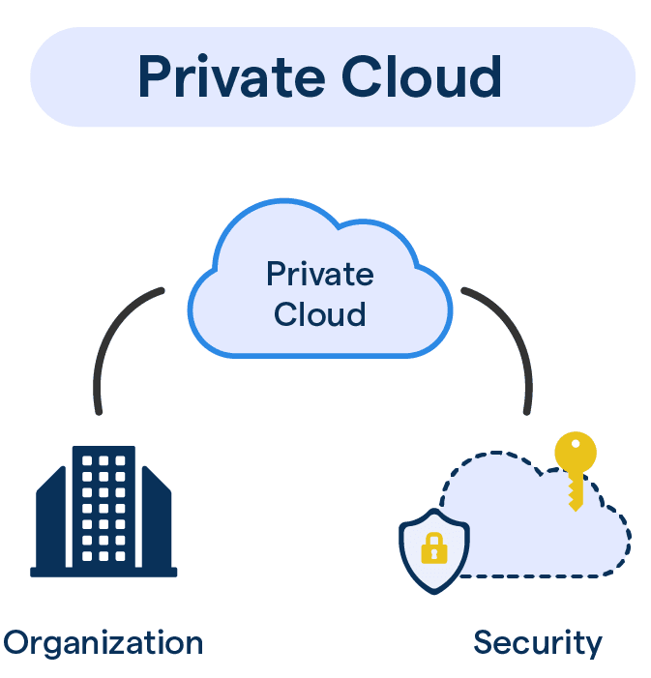
🏢 Private Cloud Security Level
Used exclusively by one organization (single-tenant).
Full control over infrastructure, data, and security policies.
Better suited for sensitive or regulated data (healthcare, finance).
Customizable compliance and encryption.
More manual effort and higher cost, but better isolation.

Slide 4


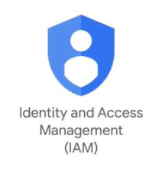
Types of Security Offered in Public & Private Cloud
👤Identity & Access Management (IAM)
Public: IAM services, RBAC, MFA (e.g., AWS IAM, Azure AD).
Private: LDAP/Active Directory, internal MFA setup.
🔐Network Security
🔒 Data Security
Public: Virtual firewalls, DDoS protection, VPC, IDS/IPS services.
Private: Traditional firewalls, VLANs, custom IDS/IPS systems.
Public: Encryption at rest and in transit, key management services.
Private: Full encryption control, custom backup & disaster recovery.

Slide 5



Continued…
📊Monitoring & Logging
Public: Built-in logs, real-time dashboards, auto alerting.
Private: Requires manual setup or external SIEM tools.
🛠️ Patch Management
Public: Handled by provider for infrastructure.
Private: Fully managed by in-house IT/security teams.
🧱Application & Endpoint Security
Public: Cloud-native WAFs, malware scanning, API security.
Private: Manual or third-party endpoint protection and WAFs.

Slide 6
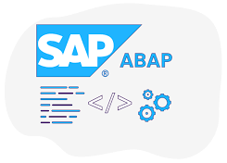
Activities We Can Use for ABAP Task List
ABAP task lists (T-Code STC01) help automate and execute grouped SAP Basis tasks.
📌 Common Activities in ABAP Task Lists
System Conversion (e.g., SAP S/4HANA migration)
SAP Fiori activation and configuration
Post-installation steps
Custom Code Check
Add-On installation support
Transport and configuration synchronization
Health checks or consistency checks
Client-specific configurations
Cleanup and housekeeping tasks
📌 Task List Examples:
SAP_BASIS_SETUP_INITIAL_CONFIG
SAP_BW_SETUP_INITIAL
SAP_GATEWAY_BASIC_CONFIG
SAP_FIORI_FOUNDATION_S4

Slide 7


Scenario That We Can Automate Task Lists
✅ Scenario: Automate Fiori setup in a new client.
📋 Step-by-Step Using STC01
Step 1: Open Tcode: STC01
Enter the task list name, e.g., SAP_FIORI_FOUNDATION_S4.
Step 2: Specify Target Client
Select the client where tasks will be executed.
Optional: Create a transport if config changes are needed.
Step 3: Execute in Background or Foreground
Choose foreground for step-by-step monitoring.
Choose background for full automation (scheduled).
Step 4: Review and Monitor Logs
Each task provides logs and return codes.
You can re-execute failed steps selectively.

Slide 8

Thank You
for your attention
15,April 2025

